Slide 1

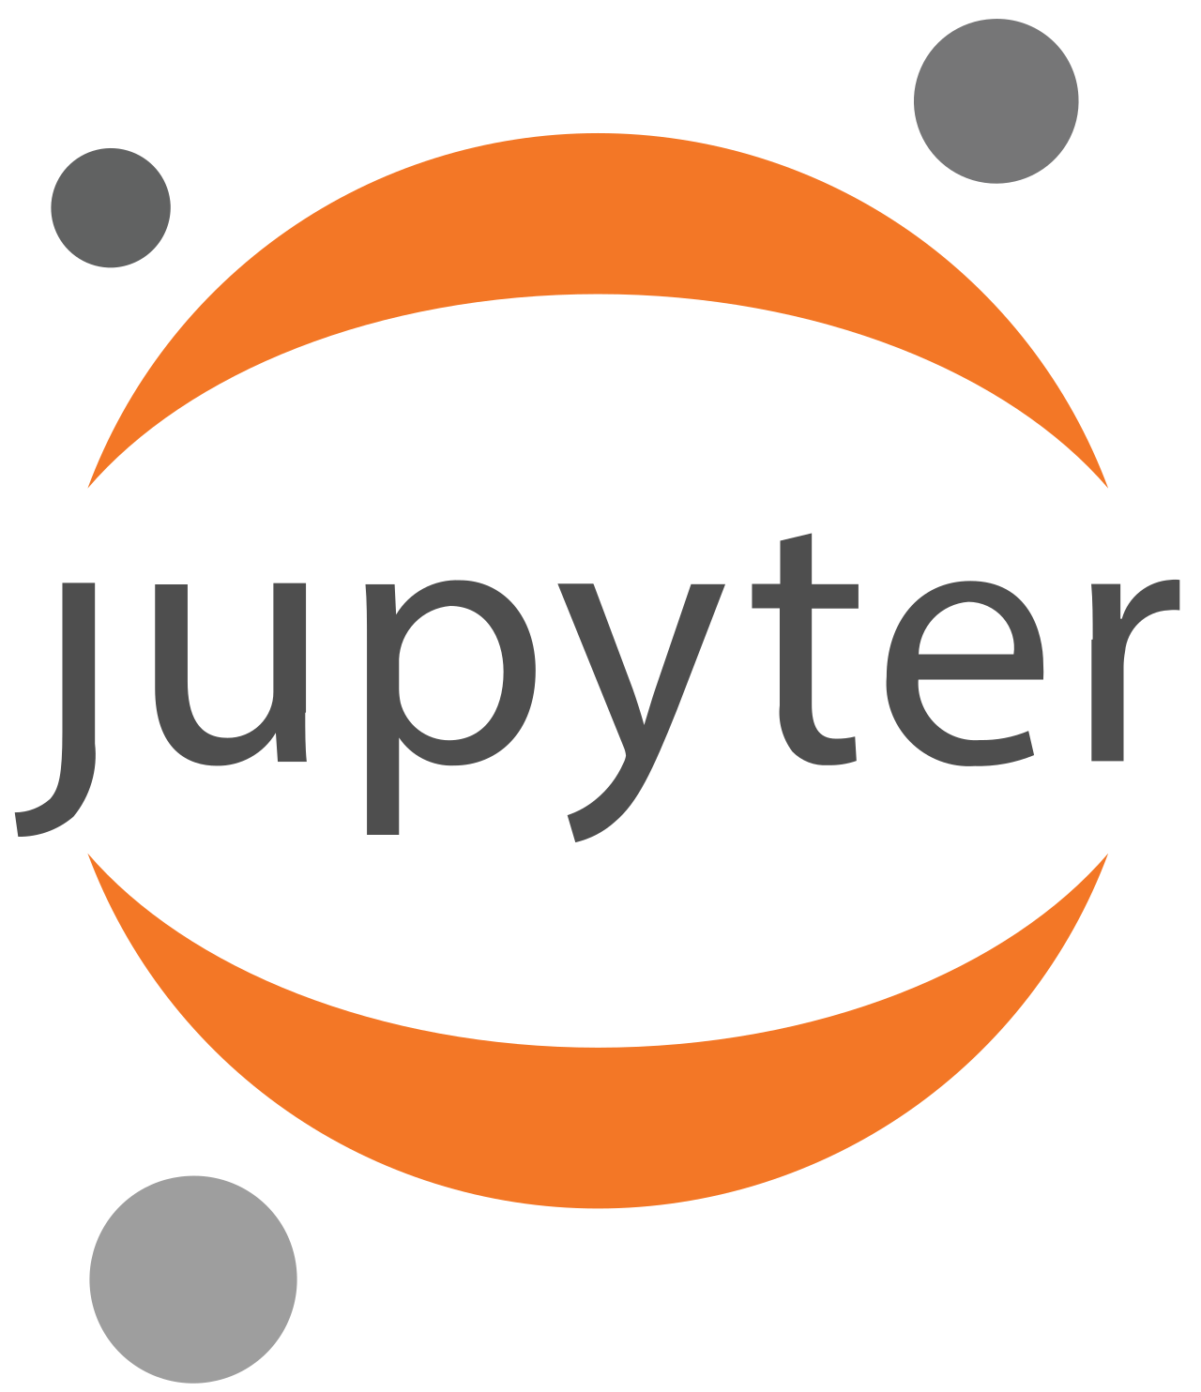
The Cloud, CLIMB and Notebook Servers

Slide 2
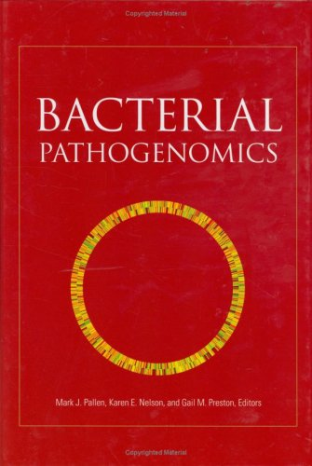
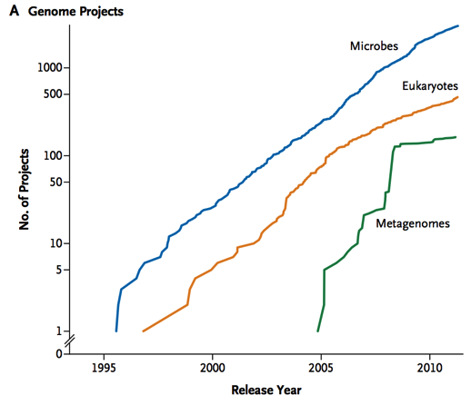
Bacterial Genomics The Golden Era: 1995-2007
Phase 1
Genome sequences from all significant bacterial pathogens of humans, animals and plants
Insights into pathogen biology
Phase 2
Multiple genomes from same species
Insights into genomic diversity

Slide 3
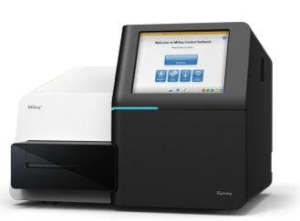
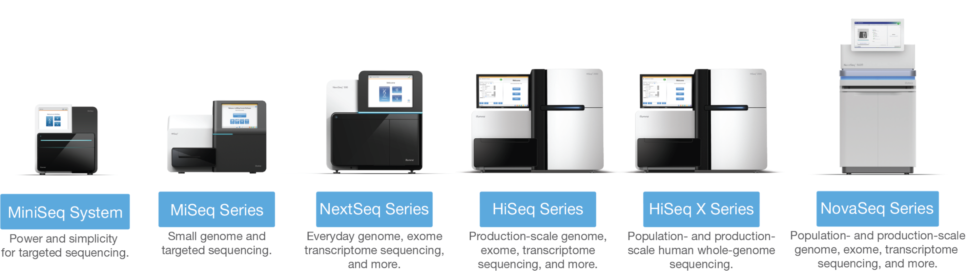
High-throughput Sequencing from 2007 onwards
>1000x faster, >1000x cheaper!
A disruptive technology
Bench-top sequencing easy, quick and cheap enough to have an impact on real-world clinical problems
Illumina short read sequencing

Slide 4

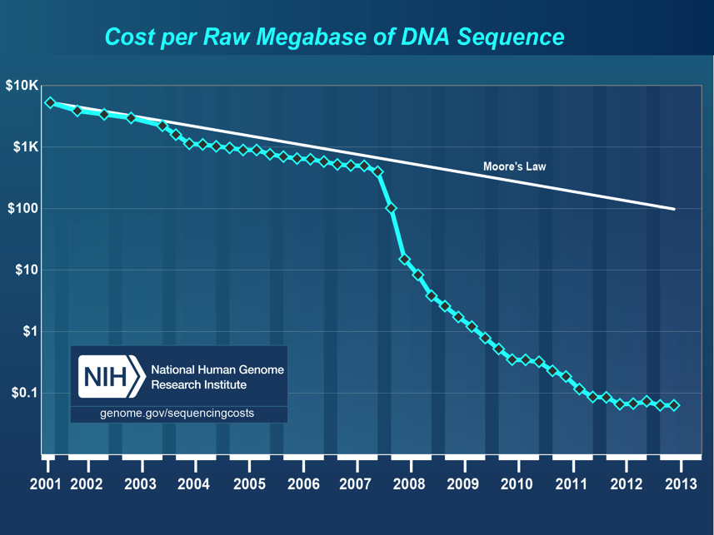
The Problems…

Slide 5

The Problem
Microbiologists in the UK are often unable to exploit large genomics datasets to address key questions in microbiology because they lack access to the relevant computational resources, bioinformatics tools or expertise in data analysis. Cloud computing provides these resources.

Slide 6

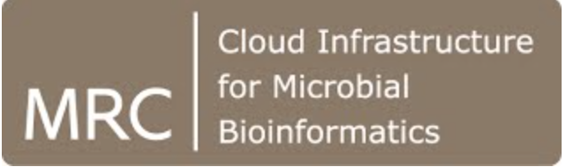
Enter the Cloud…
Cloud computing is efficient
Provides value for money
Removes hassle from end users
Cloud computing provides a mechanism for sharing data and pipelines
Allows standardisation
Enhances reproducibility
Saves research time
Makes training easier

Slide 7

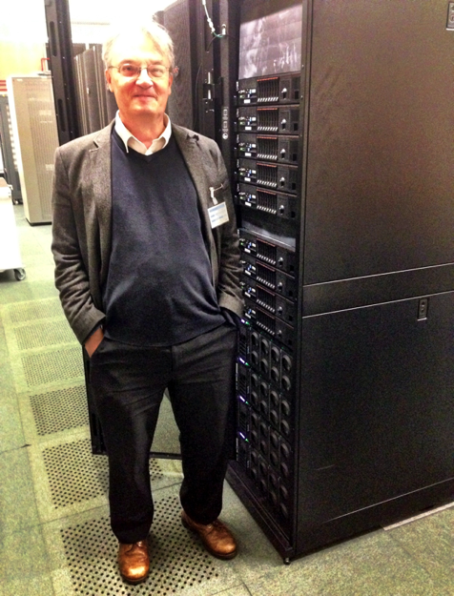
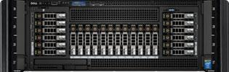
How does the Cloud work?
A user wants a server
The system spins up a virtual notebook server
a self contained ‘module’ containing
operating system and software
And slots it onto one of the servers
A user
A Datacentre
With many servers
and much storage
A user
One of the servers
A user
Other users also want systems
The Cloud OS will load those up too
Sharing a large server between users

Slide 8

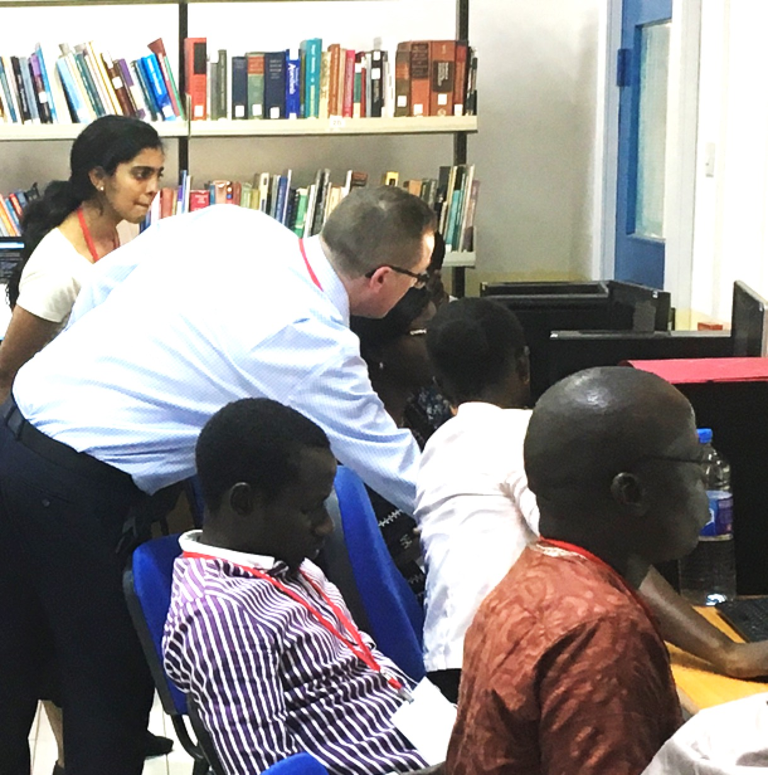



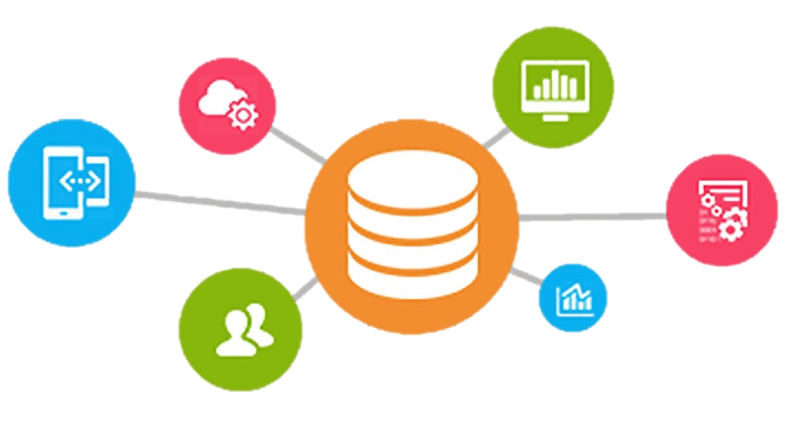







Community Engagement
Infrastructure
Symposia
Training
Graphics processing units
Enhanced storage
Hackathons
Software
Curation
Cloud-computing
Infrastructure
Workshops
Bacteria, Viruses,
Parasites, Fungi
Genomes, Metagenomes
Software
and data
Tools and Integration
Cloud Migration
Integration with external facilities
Support for public health
microbiology
Containers
Vibrant interdisciplinary team
with proven track record
Strategic Relevance
Sustainability
Expansion
Stable, resilient environment

Slide 9



Programming languages
Julia
high-level, general-purpose dynamic programming language commonly used for numerical analysis and computational science
Python
High-level, interpreted programming language known for its simplicity, readability and versatility
IPython is enhanced, interactive command-line interface for Python
R
programming language for statistical computing and data visualization. It has been adopted in the fields of data mining, bioinformatics and data analysis

Slide 10
Jupyter notebooks
Jupyter Notebook provide open-source, web-based interactive computing environment
named after Julia, Python and R
Jupyter Notebook Server runs the notebooks allowing users to interact with in real-time via the web.
Ideal for data science, scientific research, and collaborative development.
Supports sharing, exporting to multiple formats (HTML, PDF), and saving notebooks with all outputs

Slide 11
Jupyter Notebook Servers
allow you to create/manage Jupyter notebooks – interactive documents containing live code, equations, visualizations, and narrative text
facilitates interactive computing in several programming languages, predominantly Python.
provides a web-based interface, making it accessible from any browser, anywhere.
supports various kernels, enabling code execution in different programming languages.
integrates with several data science libraries and tools, enhancing functionality
enables multiple users to edit and run the notebook in real-time, promoting real-time collaboration

Slide 12
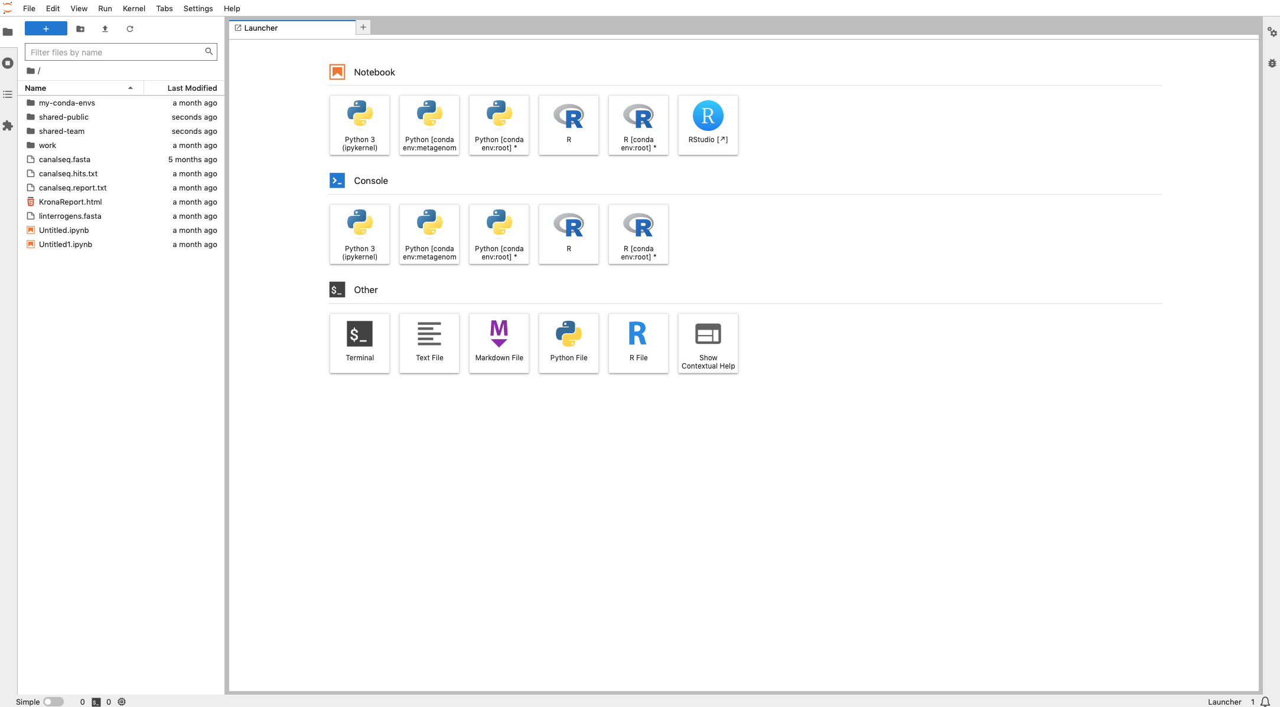


Slide 13
Rationale
offers an interactive environment, making it easier to test and debug code iteratively
supports rich outputs with HTML, images, videos, LaTeX, and custom MIME types
language agnostic: supports various languages, not limited to Python, such as R, Julia, and Scala
accessible from anywhere: being web-based, can be accessed remotely, facilitating distributed development
easy to share: can be easily shared among colleagues, supporting collaborative work
educational use: widely adopted for teaching coding and data science, due to its interactive nature

Slide 14
Advantages
provides a user-friendly, graphical interface, not just command-line
allows direct interaction with the code and immediate feedback, enhancing the development process.
supports integrated data visualizations, which conventional servers might lack.
documentation Integration: combines code with narrative text, facilitating documentation and explanation of the logic.
extensibility: offers a variety of extensions and widgets to enhance functionality, which might be limited in conventional servers.
accessibility and sharing: easy accessibility and sharing options make collaboration smoother compared to conventional servers.

